Slide 1
Introduction to Wide Area Networks (1)

Slide 2
3 Major Characteristics
Broader Geographical Area
Uses the services of Carriers such as Telephone Companies, Cable Companies, Satellite Systems, ISPs
Uses Serial Connections of various types to provide access to BW over large geographical area

Slide 3
LANs and WANs
LANs studied up to now are completely controlled by the user/owner
WANs do the job of linking of LANs together over long distances using many varied technologies and protocols
With WANs the technologies involved can be very expensive and these are owned by a service provider. You pay for the use in terms of BW and amount of data

Slide 4
The Various WAN Technologies
Ideally the WAN should transmit the data from one computer to another quickly and without error
To some extent the WAN is defined by the method of the data transmission
WANs generally work at OSI levels 1 and 2
Some WANS are private built by huge corporations, some are built by ISPs for public shared use allowing access to the Internet

Slide 5
The Various WAN Technologies (cont)
Options available for WAN connectivity are:
Leased Line (T1, T3, E1, E3 and others)
Circuit Switched (Analogue Dial-UP, ISDN)
Packet Switched (X.21, X.25, Frame Relay)
Cell Switched (ATM)
This presentation will look at the first two technologies

Slide 6
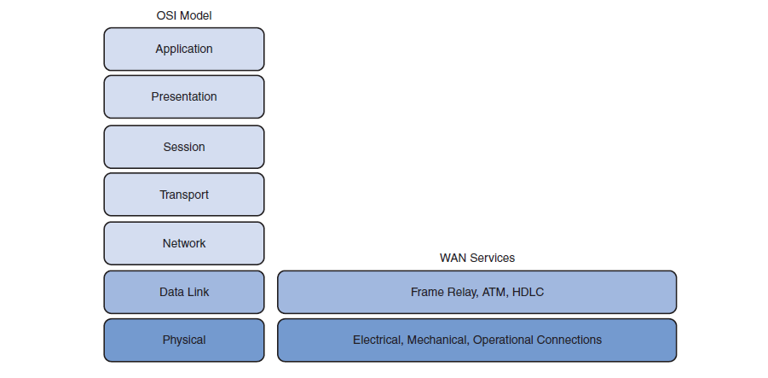
WANs related to OSI Model

Slide 7
Some Standards Authorities for WANs
ISO – International Standards Organisation
TIA – Telecommunication Industry Association
EIA – Electronic Industries Alliance
ITU – International Telecommunication Union
(formerly known as CCITT)

Slide 8
Some Telecomm’s Terminology
DTE- Data Terminal Equipment
The source or end of the serial comms connection
DCE- Data Communications Equipment
This device is connected to the DTE and provides the interface for the communications channel
CSU/DSU- Channelised Service Unit/ Data Service Unit
Required when using Leased Lines such as T1, T3, E1, E3

Slide 9
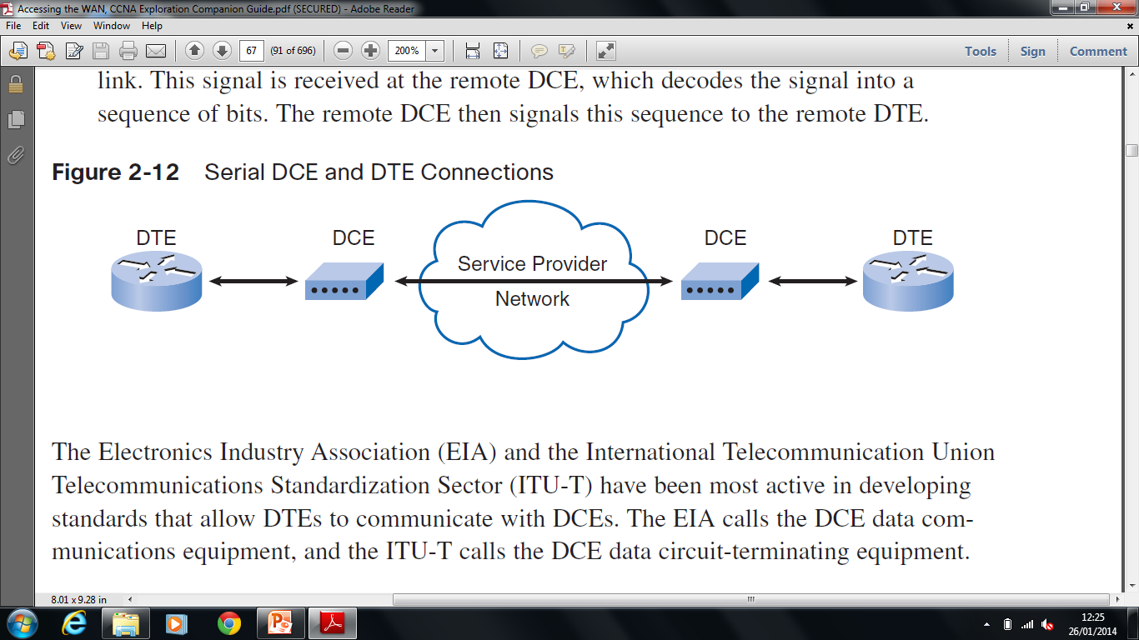
DTE and DCE in Use

Slide 10
Some DTE/DCE Interface Standards
EIA/TIA-612/613
This standard describes the High Speed Serial Interface (HSSI) protocol which provides access to services up to 52Mbps on a 60 pin D connector
V35
This is the ITU-T (International Telegraph Union standard for Telecommunications). The standard for synchronous communications between a network access device and a packet network. Supports rates up to 2.048 Mbps using a 34 pin rectangular connector
X.21
This protocol is an ITU-T standard for synchronous digital communications using a 15 pin D connector

Slide 11
Some Telephone Terminology
Demarcation Point
This is the point where the phone line enters your property. In side the your property is your responsibility. Outside is the Service providers responsibility.
Local Loop
The connection between your property and the local exchange (CO). This is simply a pair of copper wires. The characteristics of this media has a major effect on your connection speed
CO (Central Office)
Known to us as the Local Exchange . Due to a program of continual updating other media are available from here such as Fibre.
CPE
Customer Premises Equipment. The equipment in your house

Slide 12
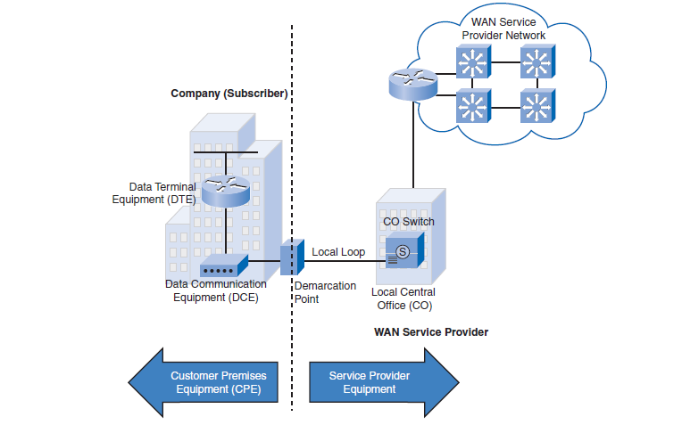
Terminology in Use

Slide 13
Circuit Switched Connection
The most common of this type is the telephone call. There are 3 stages to a Circuit Switched Connection:
Establish connection
Communicate
Break connection
As stated this type of connection is used with Analogue Dial-Up and ISDN

Slide 14
Advantages/Disadvantages of Circuit Switched Connection
Advantages | Disadvantages
Simple implementation and Low cost
Time overhead of establishing the connection which can vary
Not restricted to one destination as you can dial up any destination that supports dial-up
Quality can vary between connections
Cheap Audio communication possible with ISDN
Low speed data rates (<56kbps) unless ISDN used
Wasteful of BW if no communication takes part during connection
Low Latency (Delay time from transmission to reception)
Due to PSTN being used along with other users Security can be an issue

Slide 15
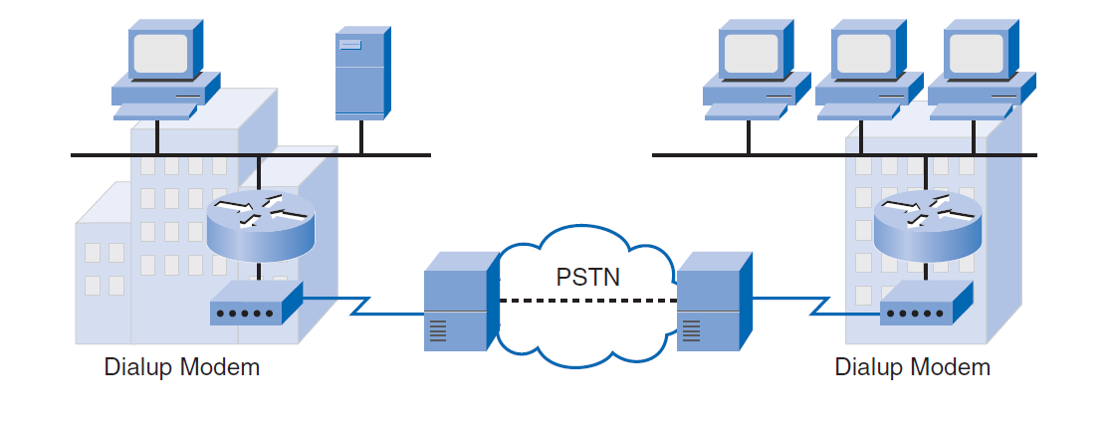
Analogue Dial-Up

Slide 16
ISDN (Integrated Services Digital Network)
This allows the local loop to carry digital signals resulting in higher speeds.
ISDN uses TDM (Time Division Multiplexing) digital signals. This allows 2 or more bit streams to be transmitted as sub-channels of one communication channel.
Typical speeds depend on the type of ISDN connection.
BRI (Basic Rate Interface) gives speeds up to 64kbps.
PRI (Primary Rate Interface) gives speeds up to 2.048Mbps (Europe). (This corresponds with leased line speeds)

Slide 17
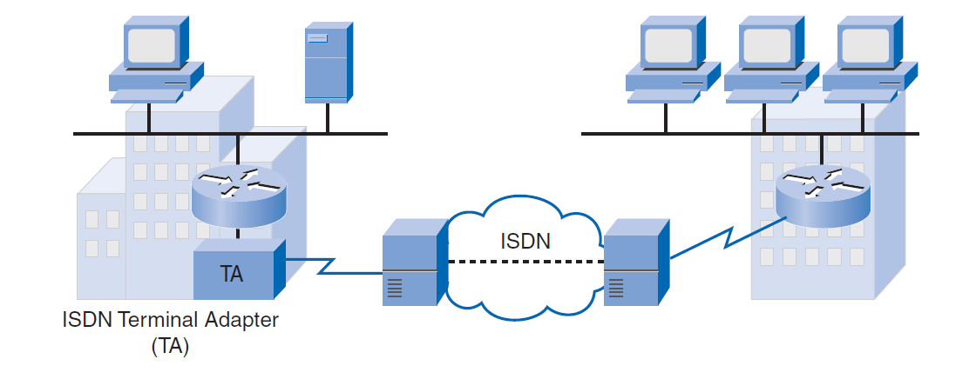
ISDN Connection

Slide 18
Leased Lines
These are dedicated lines that provide full time service to the user at a price dependant on the speed.
The user leases the line and gets guaranteed BW for all communications.
Even if the line is not used, the user still has to pay
Being that you are the only user communications is more secure
Usually used by large companies
In a sense, these are sometimes categorised as circuit switched but the circuit is permanent , there is no circuit setup time

Slide 19
Leased Line Speeds
Country | Type of Line | Speed
USA | T1 | 1.544Mbps
 | T3 | 44.736Mbps
Europe | E1 | 2.048Mbps
 | E3 | 34.368Mbps

Slide 20
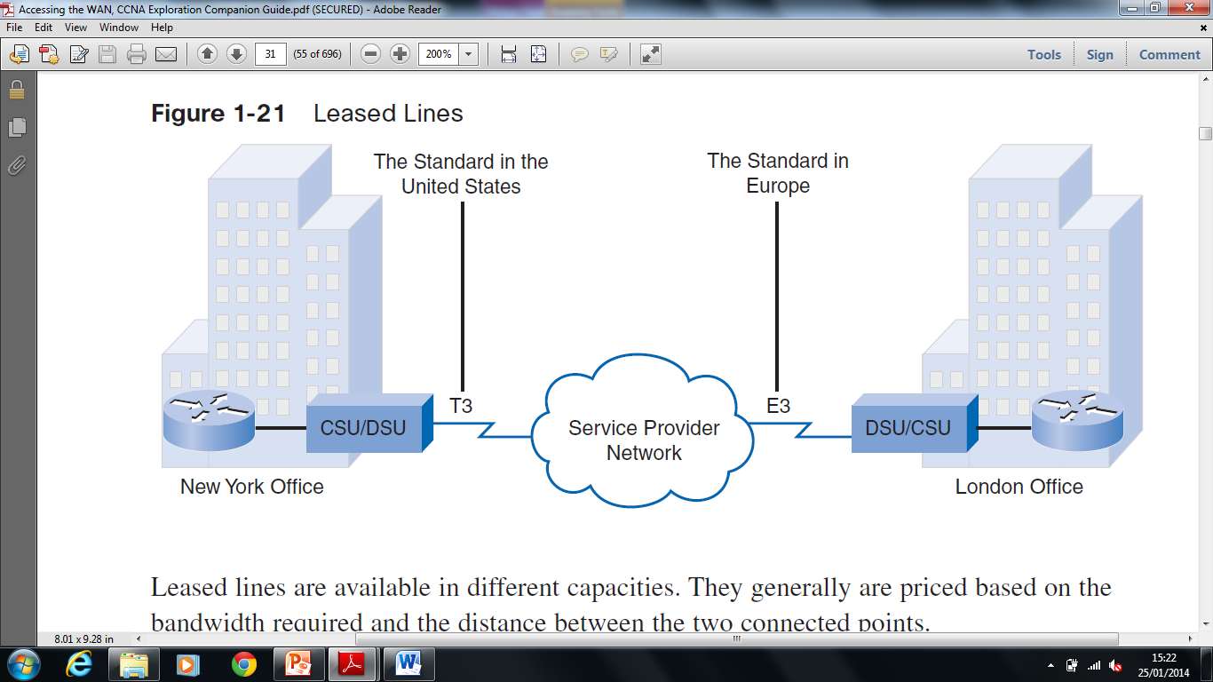
Leased Lines

Slide 21
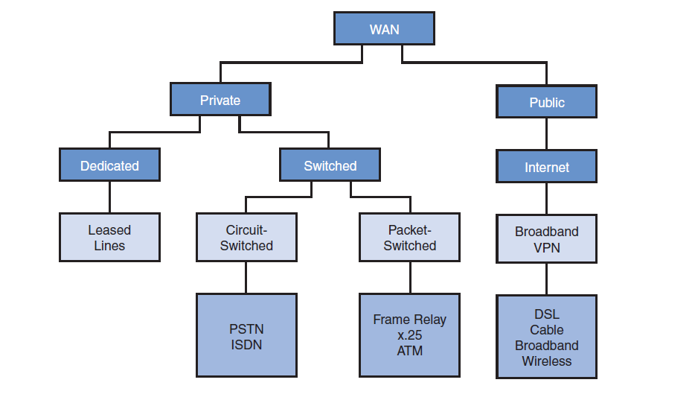
Overview of Connection Options

